Slide 1
Search Query Builder for Literature Reviews – Part 2
Ankie Fan

Slide 2
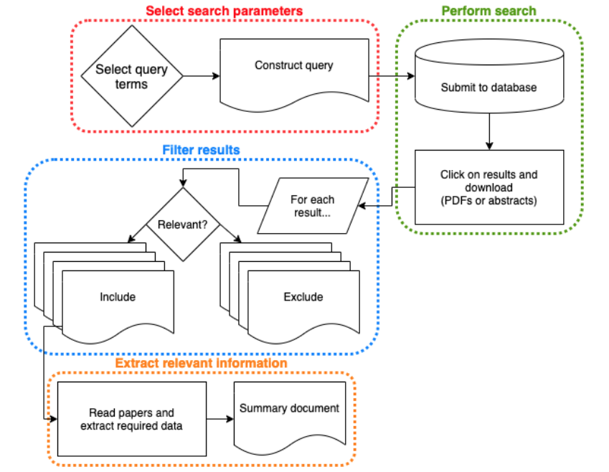
What are we going to do:
Produce user search terms (keywords)
Provide a graphical interface for user to easily construct a search strategy
Figure 3

Slide 3
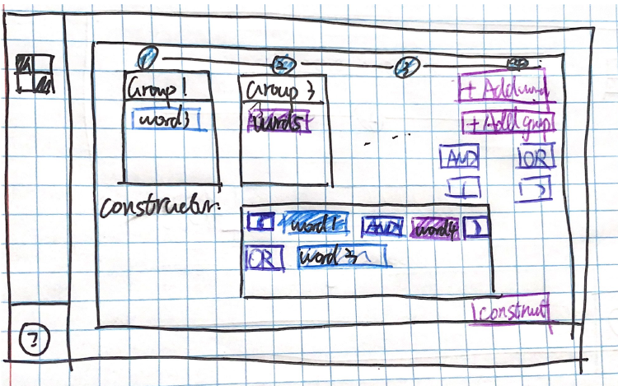
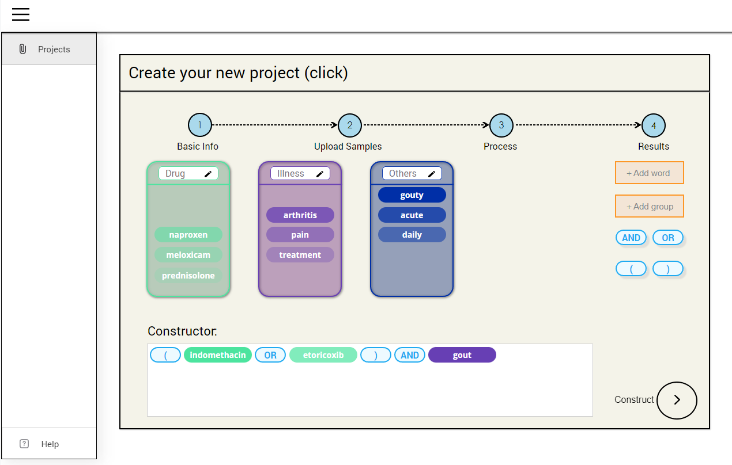
High-fidelity Prototyping

Slide 4
Demo

Slide 5
User Test
First stage: 2 versions (click/drag)
Users: literature review team in library (main users)
Goal: choose/update one from 2 versions
Method: face-to-face discussion
Second stage: 2 groups
Group 1: Normal students (bachelor, master students)
Group 2: Professional Researchers (PhD, PostDoc and researchers)
Method: questionnaires

Slide 6
Learnability
Predictability:
Steps are clear
Results are extracted from user previous input
Operation visibility:
Has obvious text tips/error reminder
Icons, combo box are used to guide users
Synthesizability:
Sample articels – clustered keywords

Slide 7
Learnability
Familiarity:
Text box, combo box are understandable
Generalizability:
Same process for every case
Input/output behaviours don’t change

Slide 8
Initial feedback (from librarians)
Uploading file step: add more instruction
Result: drag words between group
Result: add bin(drag to throw the words)
Result: automatically construct (OR in a group, AND/NOT between groups)
Result: choose the database in formulating

Slide 9
Thank you

